Slide 1
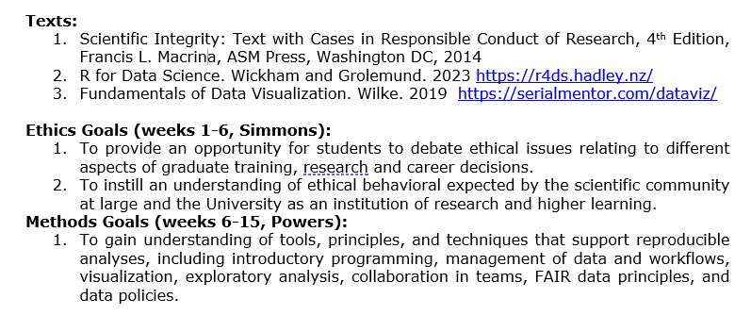

Slide 2
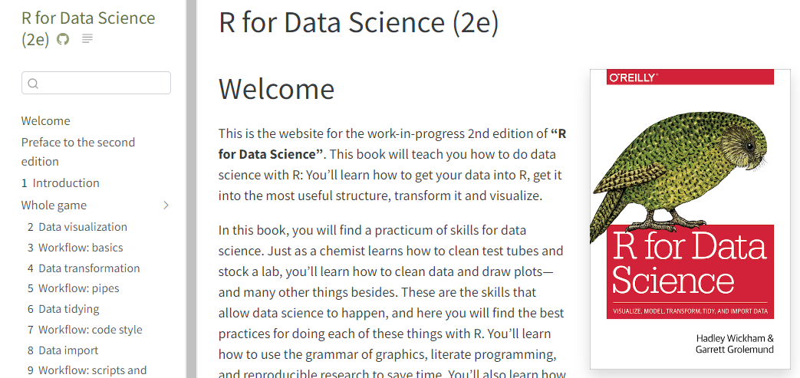
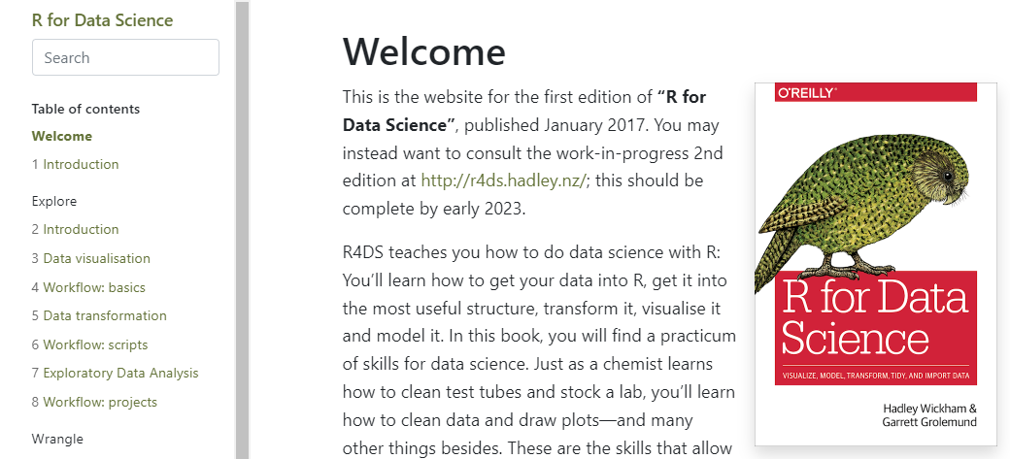
For this Wed
Read Ch 1, 2, 3 of Wickham and Grolemund
1- Intro
2- Whole game- Data visualization
3- Whole game- Workflow basics

Slide 3
Agenda for This Week
-Navigating Wickham & Grolemund
-Setting up your machine to run R code
-Accessing files on Github
-Basic R syntax
-R packages, package installation
-R cheat sheets
-Coding Exercises in Rstudio
-Logistics

Slide 4
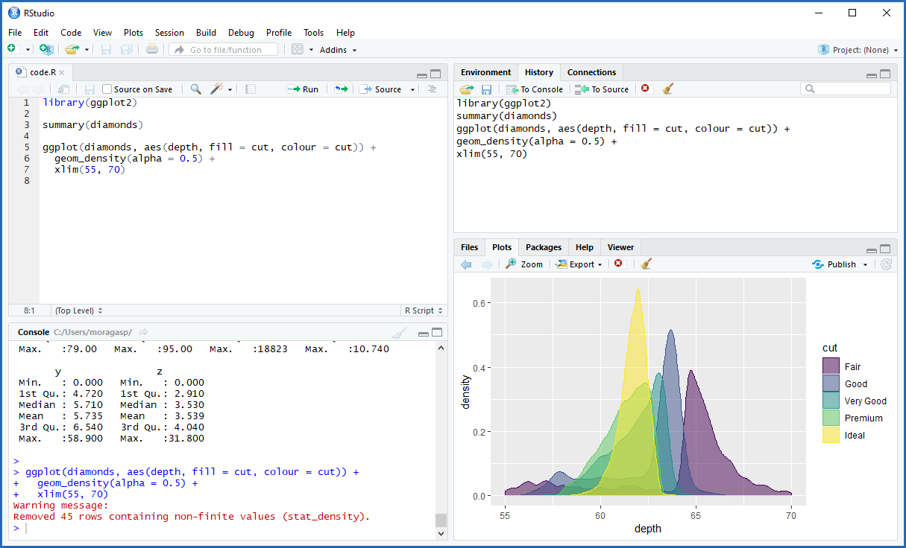
Workspace & History
Code Editor
Viewer
Console

Slide 5
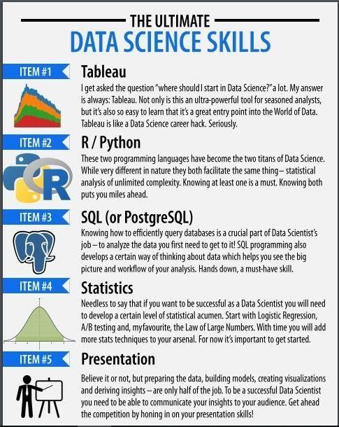
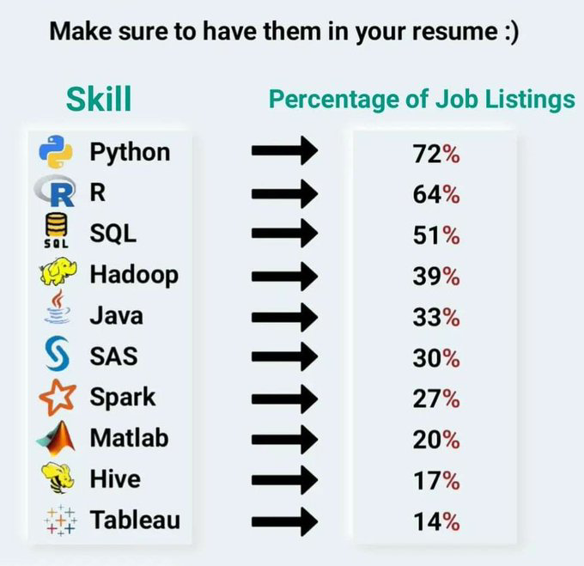
10 most common Data Science skills in jobs

Slide 6
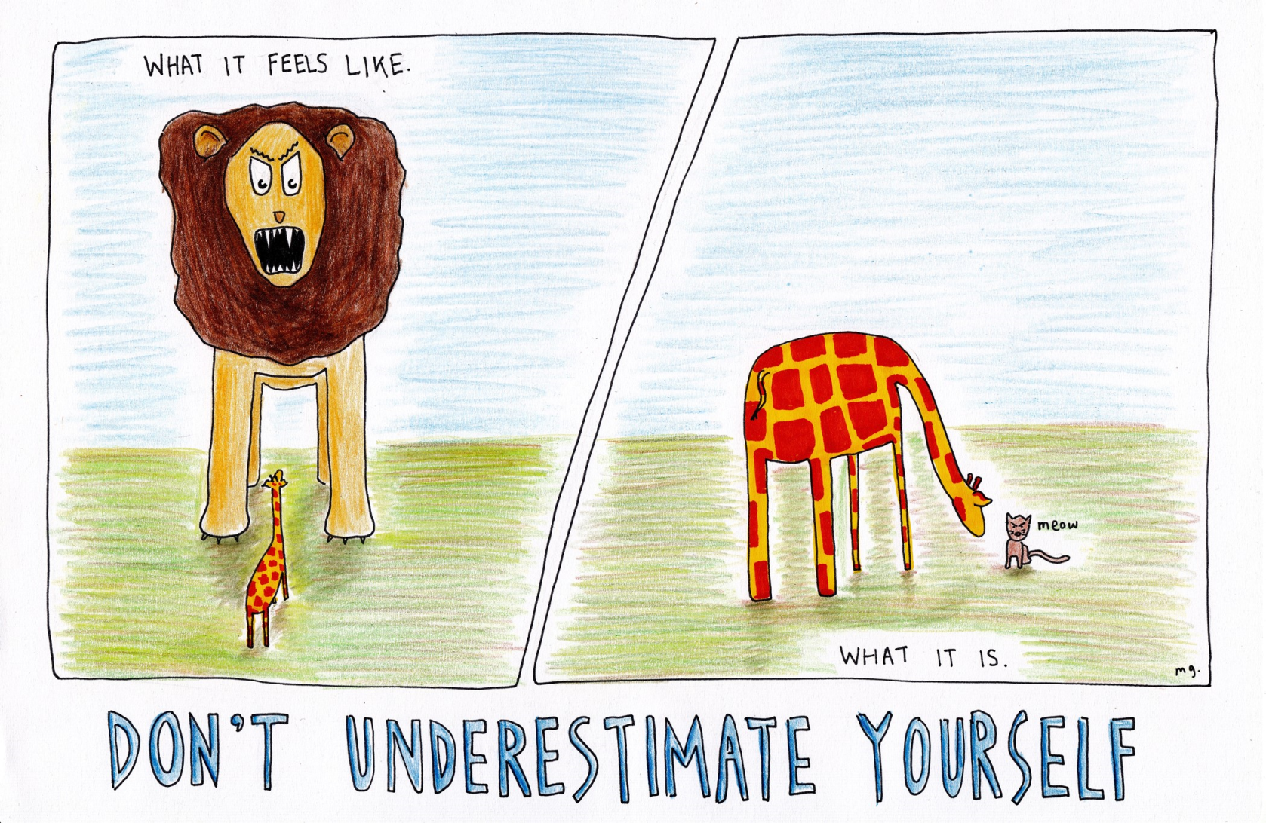
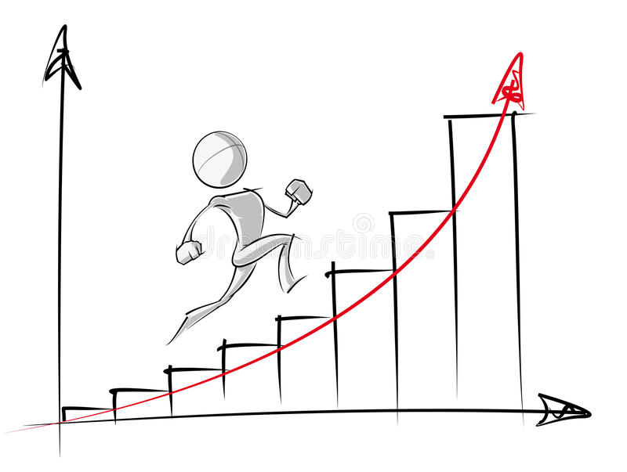
The most important lesson I will attempt to communicate in coming weeks…
Do not underestimate your ability to learn programming. You can do it.

Slide 7
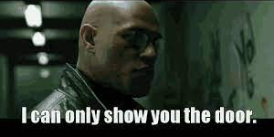
The second most important lesson I will attempt to communicate in coming weeks…
Do not expect your instructor or this course to gift you programming skills. You will need to go for it, and learn to teach yourself (beyond this course, and semester).

Slide 8

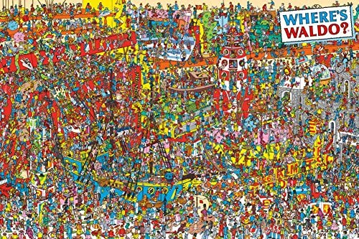
The third most important lesson I will attempt to communicate in coming weeks…
my_variable <- 10
my_varıable
#> Error in eval(expr, envir, enclos): object 'my_varıable' not found
Programming is really frustrating at first. It becomes a happier place over time. Be patient as you train your eyes and brain to inspect code extremely closely (Where's Waldo?).

Slide 9
For this Wed
Read Ch 1, 2, 3 of Wickham and Grolemund
1- Intro
2- Whole game- Data visualization
3- Whole game- Workflow basics

Slide 10
Agenda for This Week
-Navigating Wickham & Grolemund
-Setting up your machine to run R code
-Accessing files on Github
-Basic R syntax
-R packages, package installation
-R cheat sheets
-Coding Exercises in Rstudio
-Logistics

Slide 11
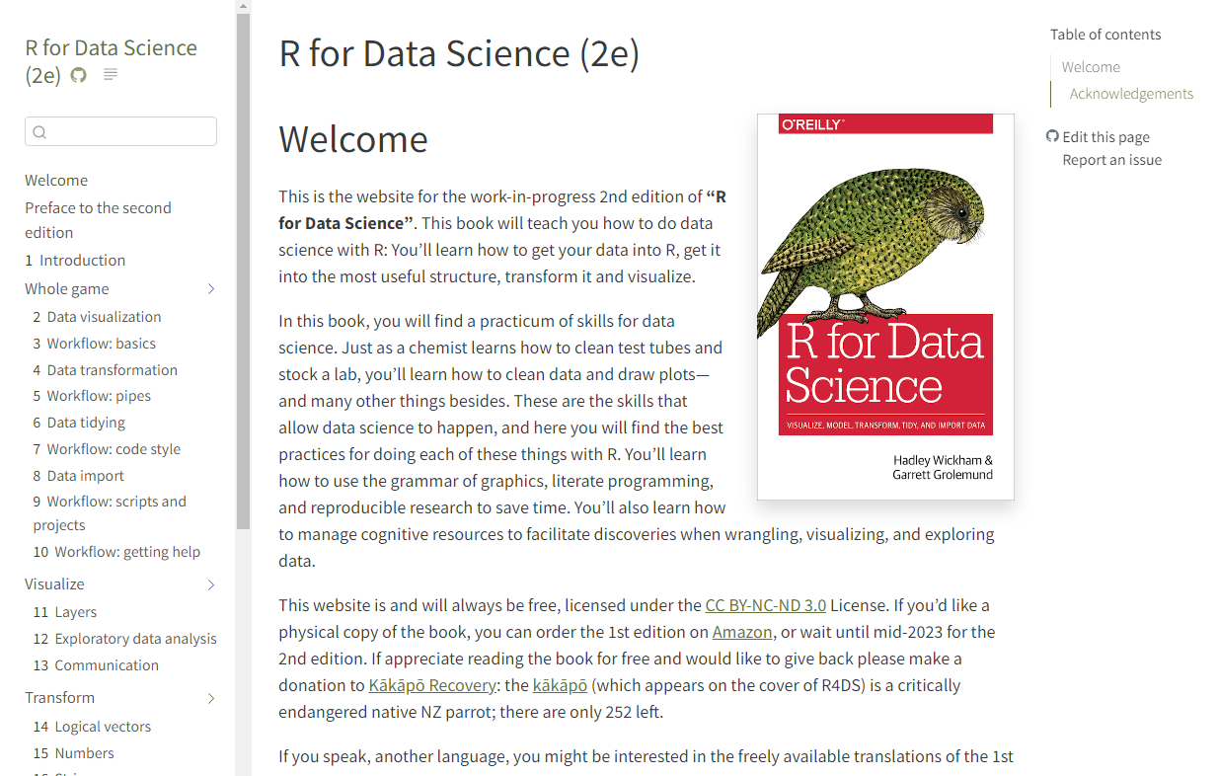
https://r4ds.hadley.nz/

Slide 12
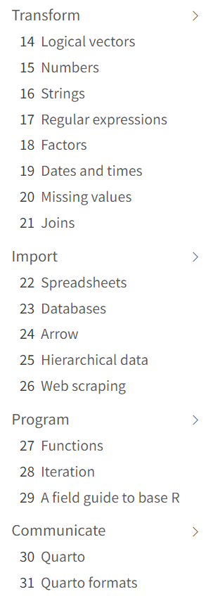
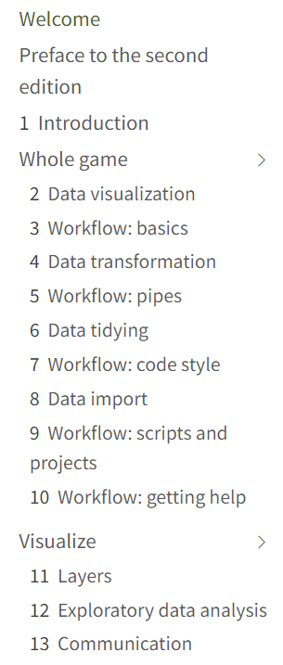

Slide 13
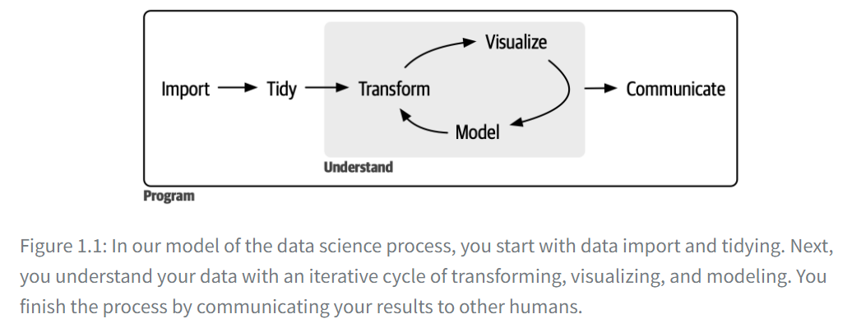
Tidy data= a term meant to provide a framework for producing data that conform to standards that make data easier to use.
Each column is a variable, and each row is an observation.
Notes:
First, you must import your data into R. This typically means that you take data stored in a file, database, or web application programming interface (API) and load it into a data frame in R. If you can’t get your data into R, you can’t do data science on it!
Once you’ve imported your data, it is a good idea to tidy it. Tidying your data means storing it in a consistent form that matches the semantics of the dataset with how it is stored. In brief, when your data is tidy, each column is a variable, and each row is an observation. Tidy data is important because the consistent structure lets you focus your efforts on answering questions about the data, not fighting to get the data into the right form for different functions.
Once you have tidy data, a common next step is to transform it. Transformation includes narrowing in on observations of interest (like all people in one city or all data from the last year), creating new variables that are functions of existing variables (like computing speed from distance and time), and calculating a set of summary statistics (like counts or means). Together, tidying and transforming are called wrangling because getting your data in a form that’s natural to work with often feels like a fight!
Once you have tidy data with the variables you need, there are two main engines of knowledge generation: visualization and modeling. These have complementary strengths and weaknesses, so any real analysis will iterate between them many times.
Visualization is a fundamentally human activity. A good visualization will show you things you did not expect or raise new questions about the data. A good visualization might also hint that you’re asking the wrong question or that you need to collect different data. Visualizations can surprise you, and they don’t scale particularly well because they require a human to interpret them.
Models are complementary tools to visualization. Once you have made your questions sufficiently precise, you can use a model to answer them. Models are a fundamentally mathematical or computational tool, so they generally scale well. Even when they don’t, it’s usually cheaper to buy more computers than it is to buy more brains! But every model makes assumptions, and by its very nature a model cannot question its own assumptions. That means a model cannot fundamentally surprise you.
The last step of data science is communication, an absolutely critical part of any data analysis project. It doesn’t matter how well your models and visualization have led you to understand the data unless you can also communicate your results to others.
Surrounding all these tools is programming. Programming is a cross-cutting tool that you use in nearly every part of a data science project. You don’t need to be an expert programmer to be a successful data scientist, but learning more about programming pays off because becoming a better programmer allows you to automate common tasks and solve new problems with greater ease.
You’ll use these tools in every data science project, but they’re not enough for most projects. There’s a rough 80-20 rule at play; you can tackle about 80% of every project using the tools you’ll learn in this book, but you’ll need other tools to tackle the remaining 20%. Throughout this book, we’ll point you to resources where you can learn more.

Slide 14
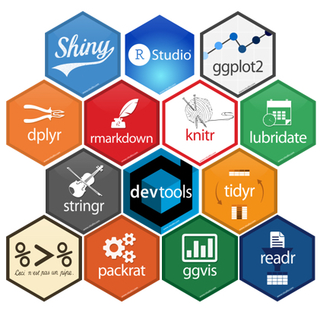
You need 4 things to run the code in this course:
1. R
2. RStudio
3. a collection of R packages called the tidyverse
4. a handful of other packages
Packages are the fundamental units of reproducible R code. They include reusable functions, documentation that describes how to use them, and sample data.

Slide 15
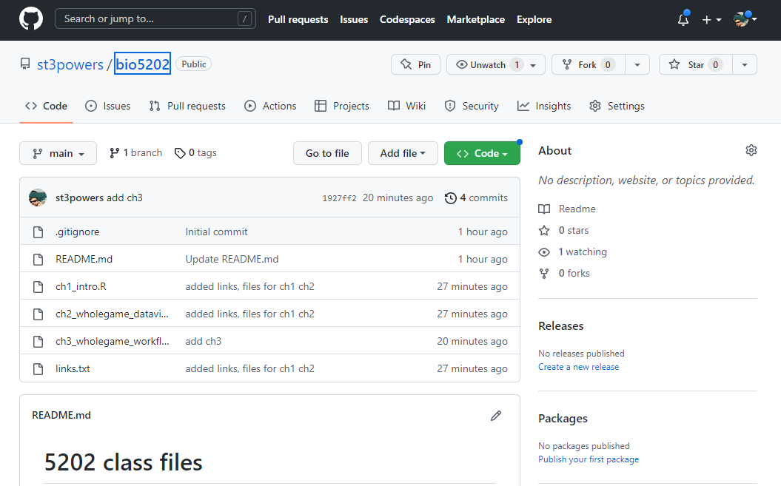

You will also need a Github account to access shared files and data

Slide 16
Workspace & History
Code Editor
Viewer
Console

Slide 17
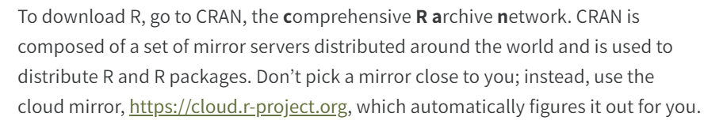
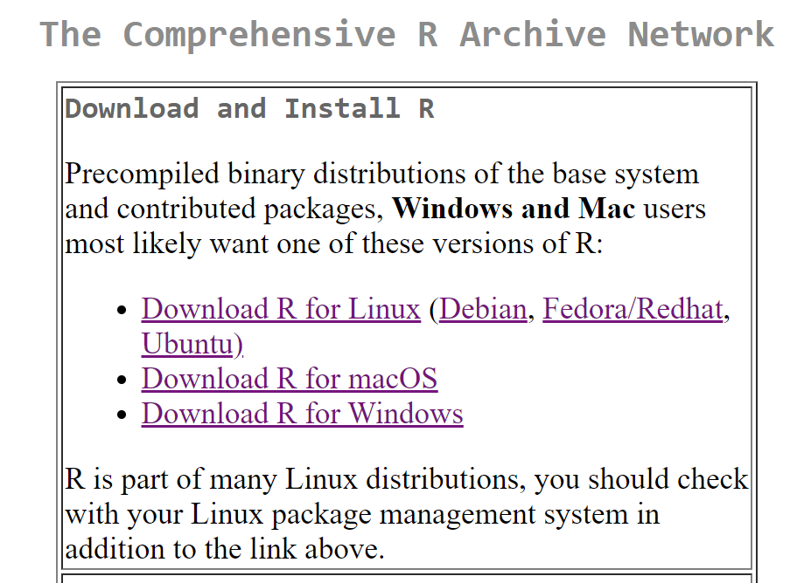

Slide 18
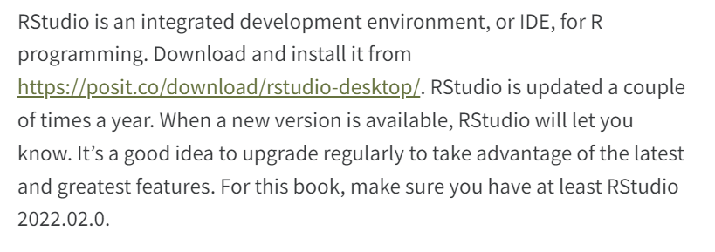

Slide 19
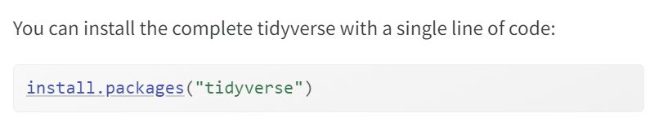

Slide 20
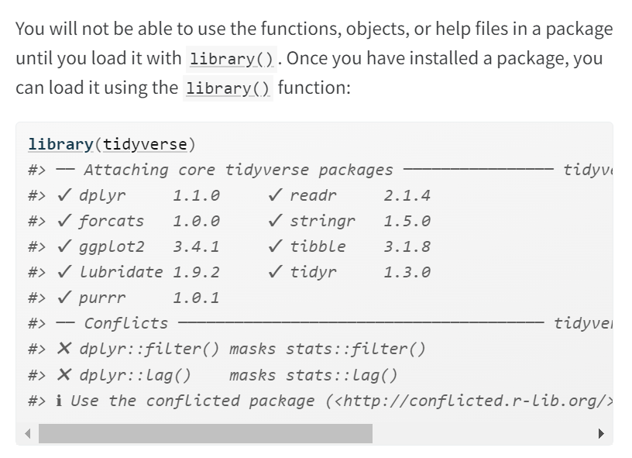

Slide 21
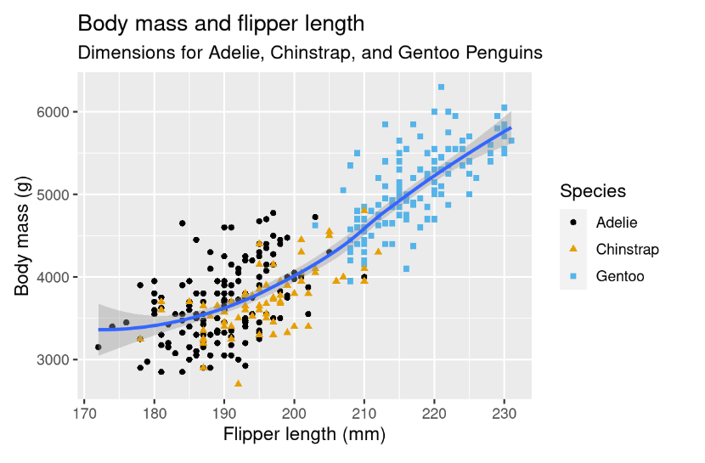
Make this plot
https://r4ds.hadley.nz/data-visualize.html

Slide 22
[break point]

Slide 23
For next week of class
(after spring break)
Read Ch 4, 5, 8 of Wickham & Grolemund
4- Whole game- Data transformation
5- Whole game- Workflow: pipes
8- Whole game- Data import

Slide 24
Pipes in R and tidyverse
Original style %>%
New style |>
Both styles should work in the recent versions of tidyverse

Slide 25
Agenda for This Week
-Navigating Wickham & Grolemund
-Setting up your machine to run R code
-Accessing files on Github
-Basic R syntax
-R packages, package installation
-R cheat sheets
-Coding Exercises in Rstudio
-Logistics

Slide 26
Make this plot
https://r4ds.hadley.nz/data-visualize.html

Slide 27
ggplot(
data = penguins,
mapping = aes(x = flipper_length_mm, y = body_mass_g)
) +
geom_point(aes(color = species, shape = species)) +
geom_smooth() +
labs(
title = "Body mass and flipper length",
subtitle = "Dimensions for Adelie, Chinstrap, and Gentoo Penguins",
x = "Flipper length (mm)", y = "Body mass (g)",
color = "Species", shape = "Species"
) +
scale_color_colorblind()

Slide 28
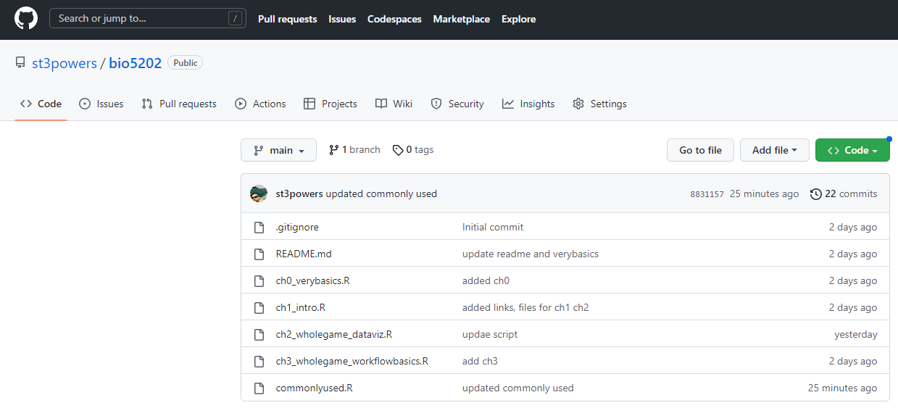
README.md

Slide 29
ch0_verybasics.R commonlyused.R

Slide 31
Do penguins with longer flippers weigh more or less than penguins with shorter flippers?

Slide 32
ggplot(
data = penguins,
mapping = aes(x = flipper_length_mm, y = body_mass_g)
) +
geom_point(aes(color = species, shape = species)) +
geom_smooth() +
labs(
title = "Body mass and flipper length",
subtitle = "Dimensions for Adelie, Chinstrap, and Gentoo Penguins",
x = "Flipper length (mm)", y = "Body mass (g)",
color = "Species", shape = "Species"
) +
scale_color_colorblind()

Slide 33
2.2.5 Exercises
2.5.5 & 2.61 Exercises

